Slide 1




Automatic Character Recognition in Porcelain Ware
David Álvarez
Santiago Garrido, Luis Moreno, Adriana Birlutiu, Manuella Kadar
Notes:
1
1

Slide 2
Automatic Character Recognition in Porcelain Ware
1 – Motivation
2 – Problem Description
3 – Segmentation Process
4 – Convolutional Neural Networks
5 – Results
6 – Summary & Future Works
Automatic Character Recognition in Porcelain Ware
Notes:
<number>
<number>

Slide 3
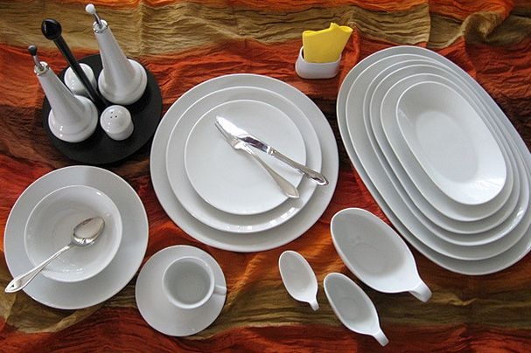
1 - Motivation
Manufacturing Process of Porcelain
Preparing the mass
Powder atomization
Shaping the object
Burning 1
Glazing
Burning 2
Quality control
Sorting
Automatic Character Recognition in Porcelain Ware
Notes:
<number>
<number>

Slide 4
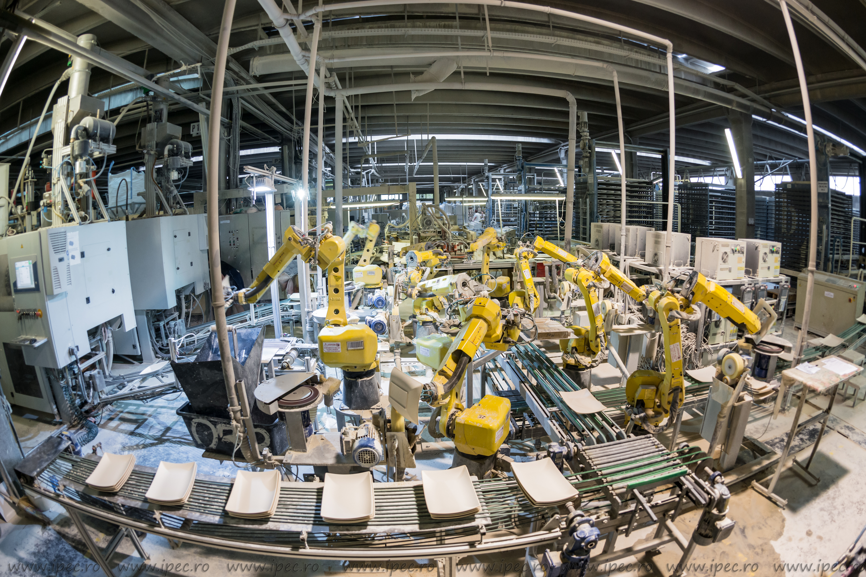
1 - Motivation
Automatic Character Recognition in Porcelain Ware
Notes:
<number>
<number>

Slide 5
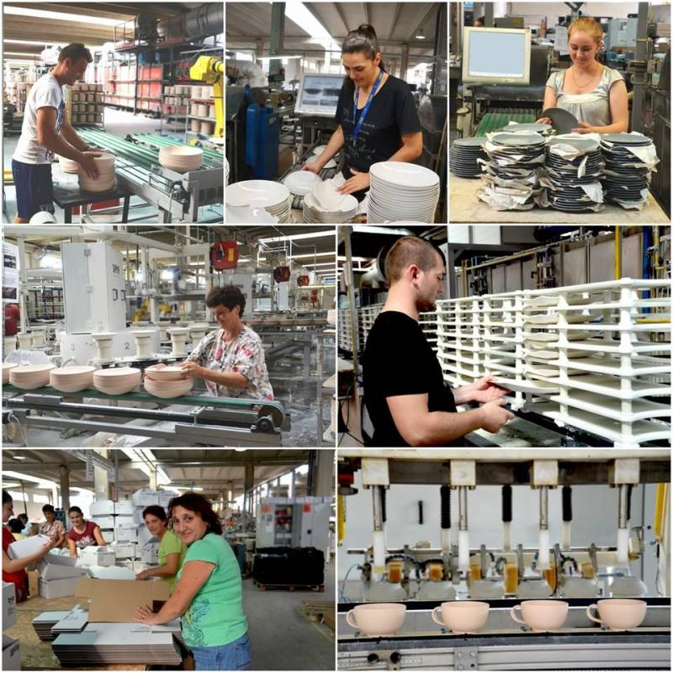
1 - Motivation
Quality control after:
1) Burning 1
2) Glazing
3) Sorting
Estimated cost reduction
- 60% in HR
- 20% materials
Automatic Character Recognition in Porcelain Ware
Notes:
<number>
<number>

Slide 6
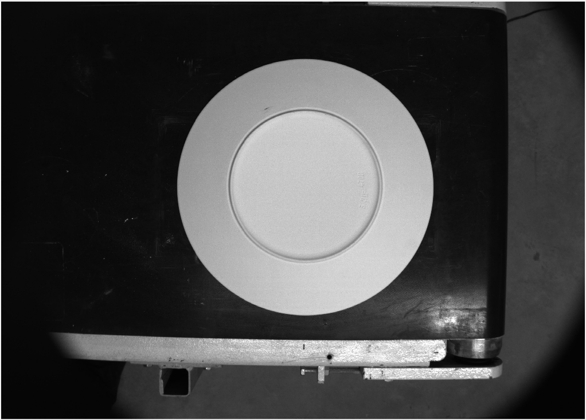
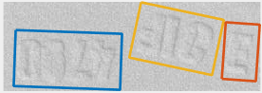
2 – Problem Description
3 groups of characters:
- Sack of material
- Shift
- Product type
SEGMENTATION
+
IDENTIFICATION
Solution:
Automatic Character Recognition in Porcelain Ware
Notes:
<number>
<number>

Slide 7
3 – Segmentation Process
Objective: segment individual characters
Solution: Recursively look for geometric properties and segment
Automatic Character Recognition in Porcelain Ware
Notes:
<number>
<number>

Slide 8
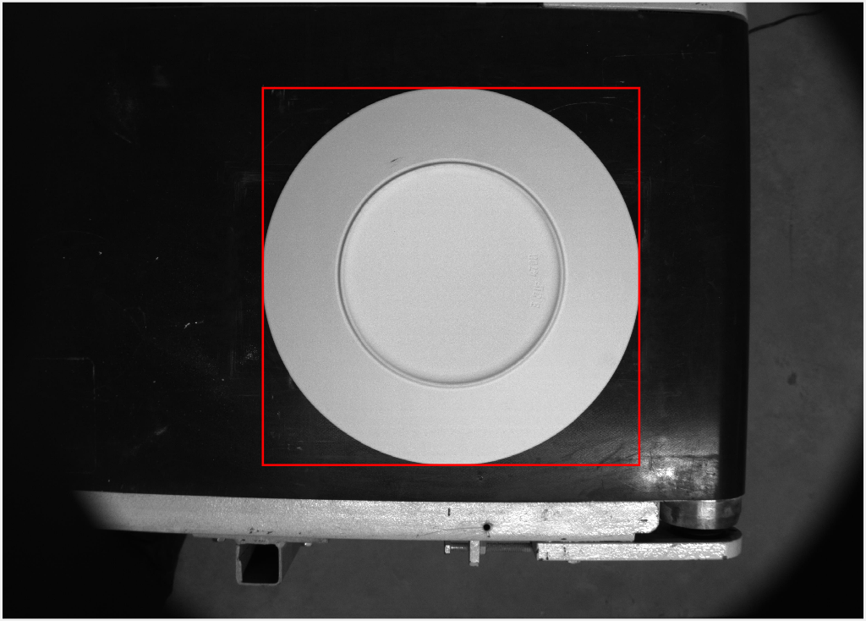
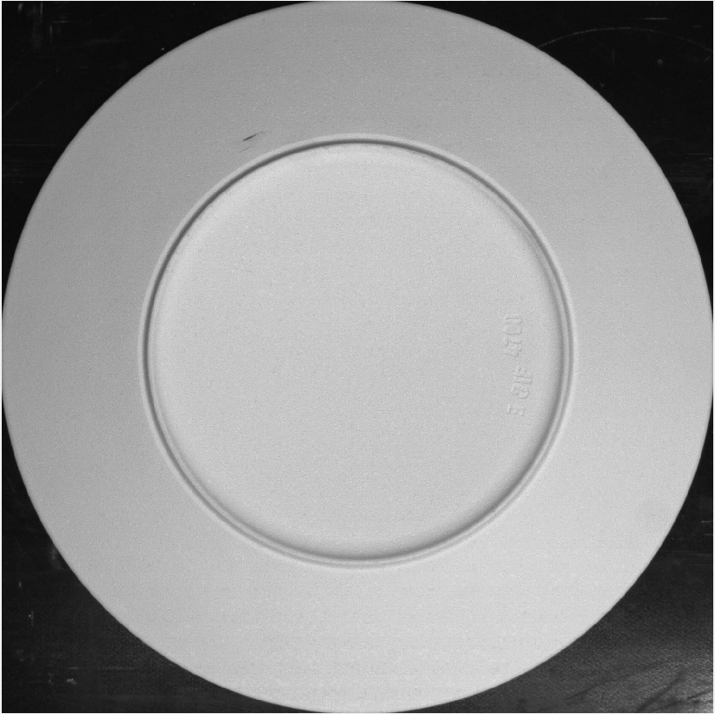
3 – Segmentation Process
Solution: Recursively look for geometric properties and segment
Outer Bounding Box of largest object
Automatic Character Recognition in Porcelain Ware
Notes:
<number>
<number>

Slide 9
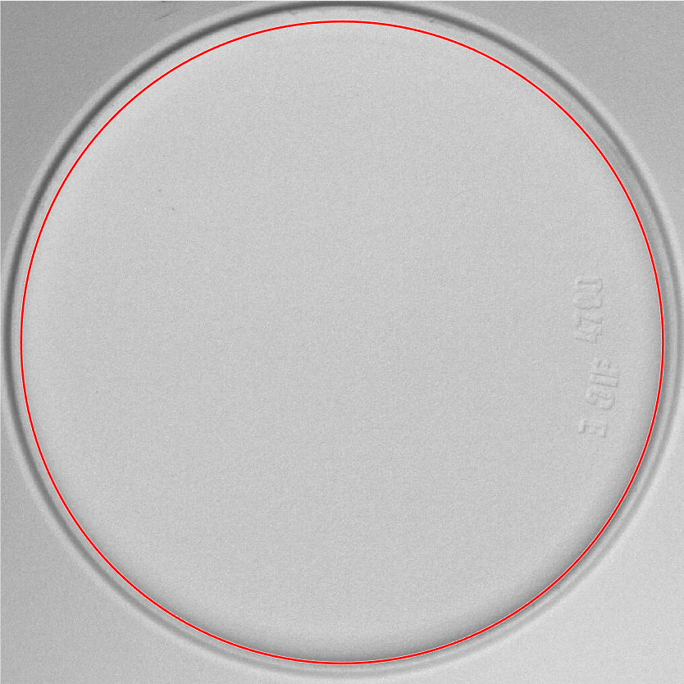
3 – Segmentation Process
Solution: Recursively look for geometric properties and segment
Segment inner circle
Automatic Character Recognition in Porcelain Ware
Notes:
<number>
<number>

Slide 10
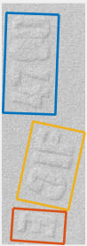
3 – Segmentation Process
Solution: Recursively look for geometric properties and segment
Automatic Character Recognition in Porcelain Ware
Notes:
<number>
<number>

Slide 11
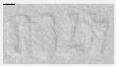
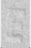
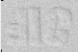
3 – Segmentation Process
Solution: Recursively look for geometric properties and segment
Size: 59*35
Automatic Character Recognition in Porcelain Ware
Notes:
<number>
<number>

Slide 12
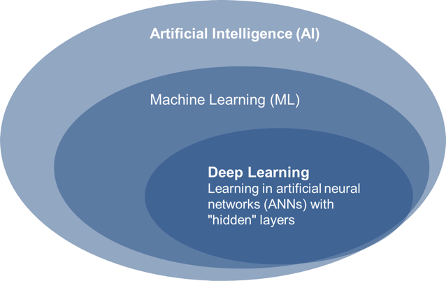
4 – Convolutional Neural Network
Automatic Character Recognition in Porcelain Ware
Notes:
<number>
<number>

Slide 13
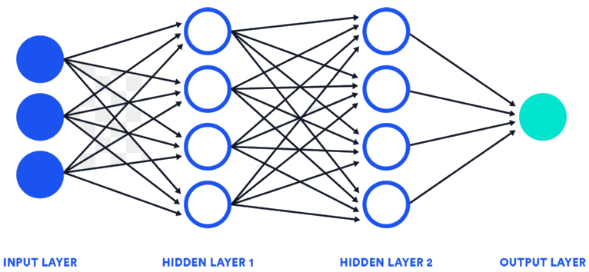
4 – Convolutional Neural Network
Automatic Character Recognition in Porcelain Ware
Notes:
<number>
<number>

Slide 14
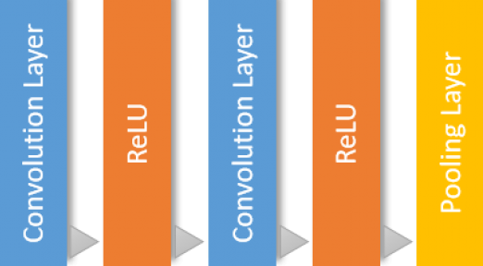
4 – Convolutional Neural Network
Hidden Layer 1
Feature extraction & Learning
Automatic Character Recognition in Porcelain Ware
Notes:
<number>
<number>

Slide 15

4 – Convolutional Neural Network
Hidden Layer 2
Softmax
Classification
Fully Connected
Classification
Automatic Character Recognition in Porcelain Ware
Notes:
<number>
<number>

Slide 16
5 – Results
Automatic Character Recognition in Porcelain Ware
Notes:
<number>
<number>

Slide 17
5 – Results
Automatic Character Recognition in Porcelain Ware
Notes:
<number>
<number>

Slide 18
6 – Summary & Future Work
Successful Character Recognition in round flat plates.
Parameterize segmentation process for other types of ware.
Add more characters to the database.
Study possible corrections for bad detections.
Automatic Character Recognition in Porcelain Ware
Notes:
<number>
<number>

Slide 19
5 – Results
Automatic Character Recognition in Porcelain Ware
Notes:
<number>
<number>

Slide 20
Automatic Character Recognition in Porcelain Ware
David Álvarez Sánchez
Notes:
<number>
<number>

